Slide 1
BODRPG
  B ook
  O f
  D iscipline
  R evision
  P reparation
  G roup (RPG for short)

Slide 2
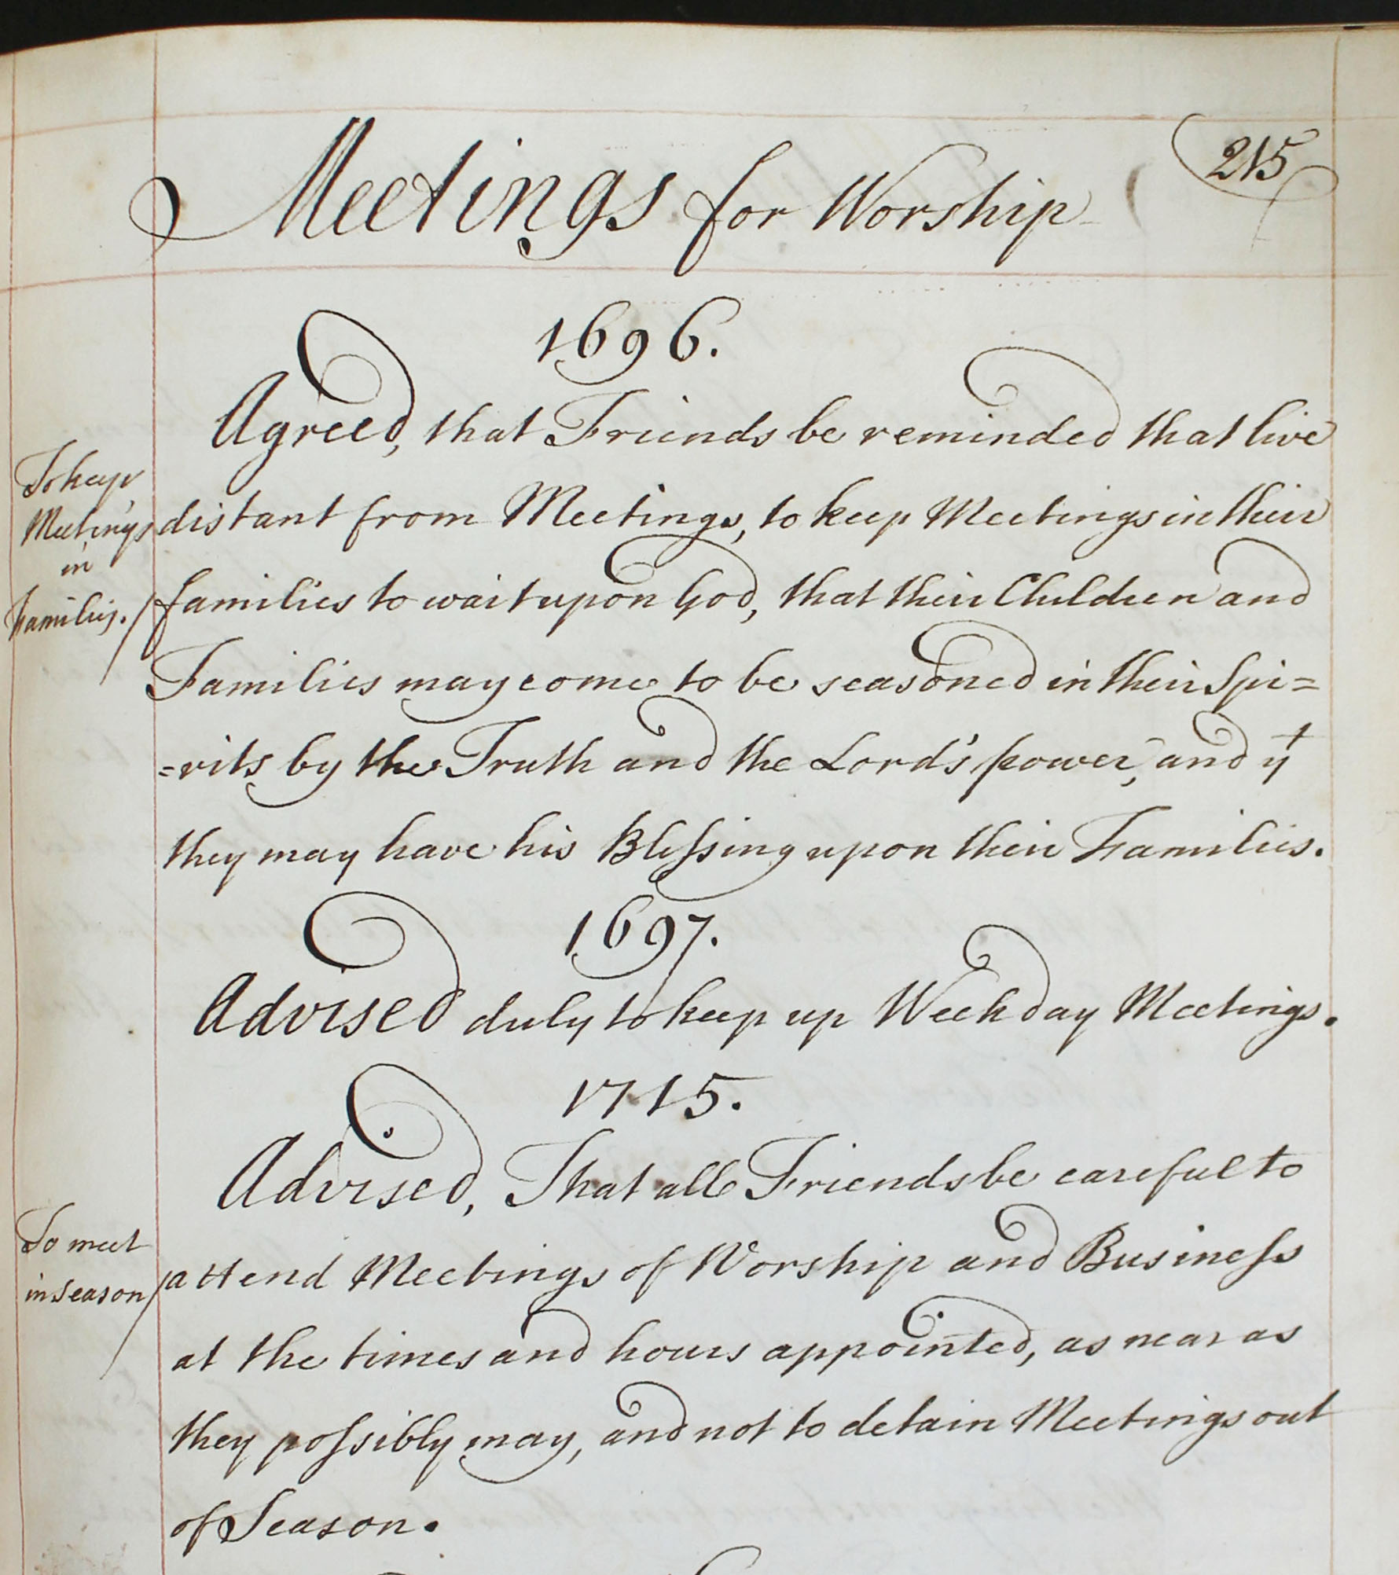

Slide 3
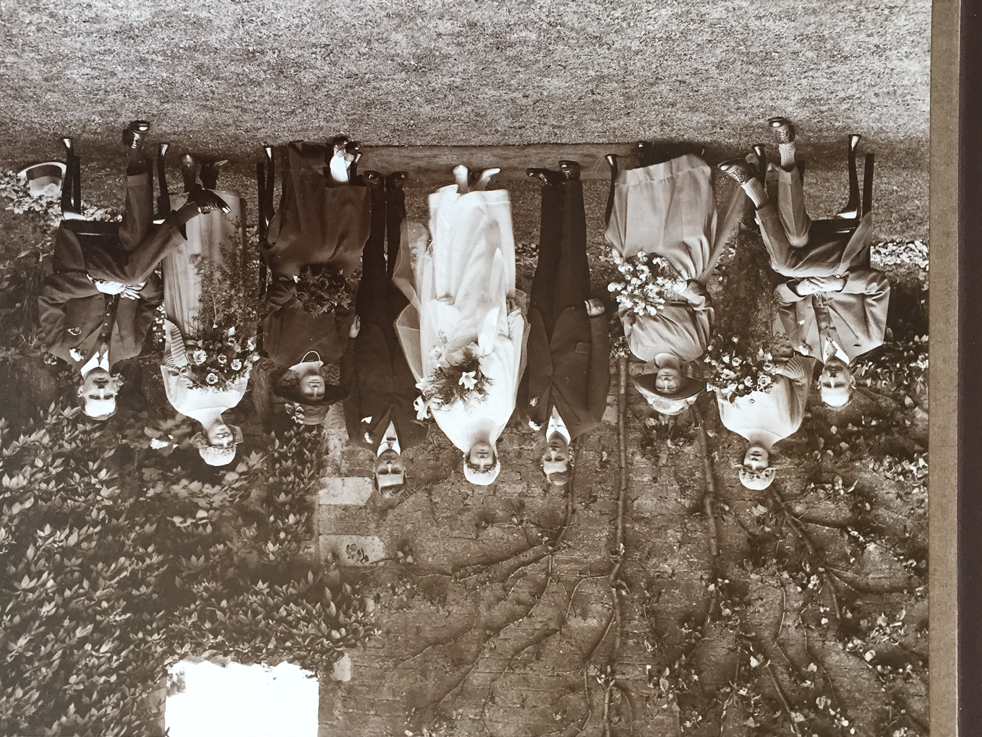
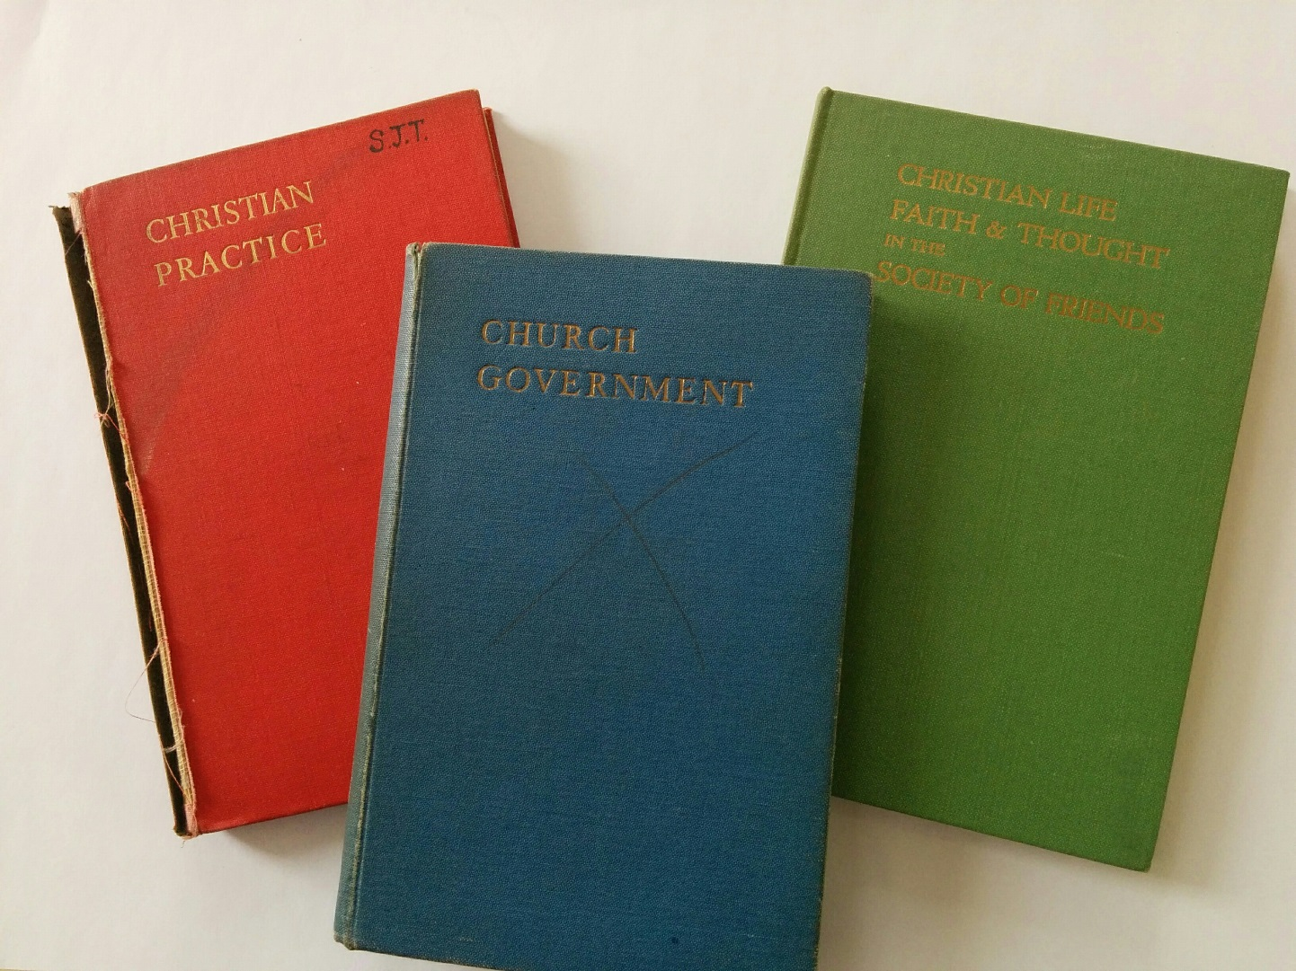

Slide 4
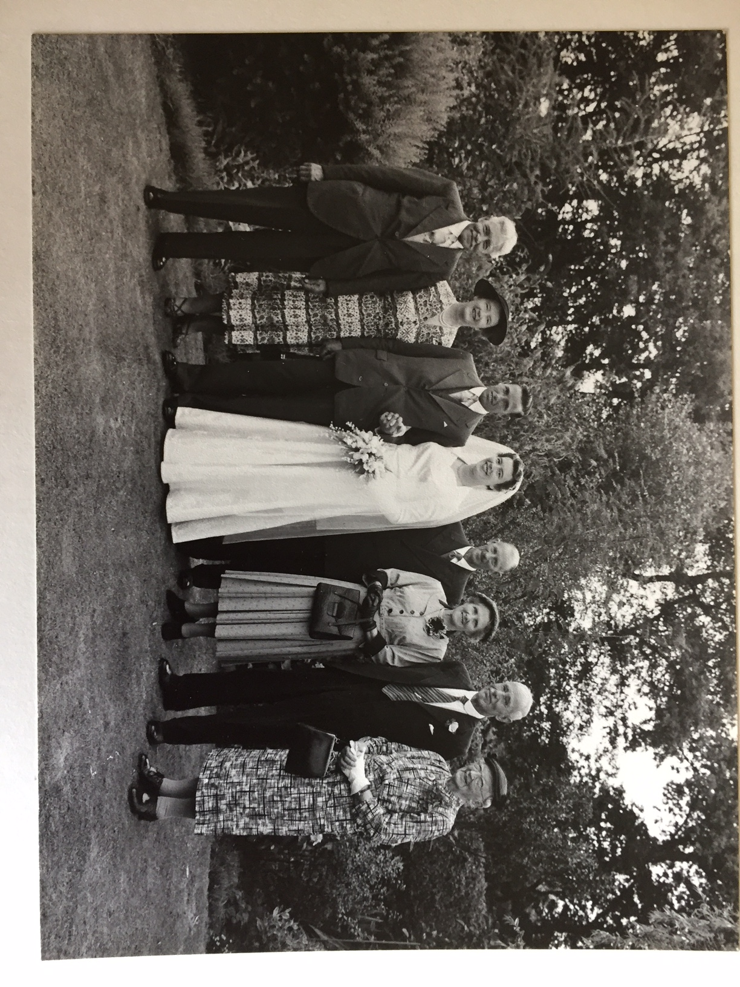
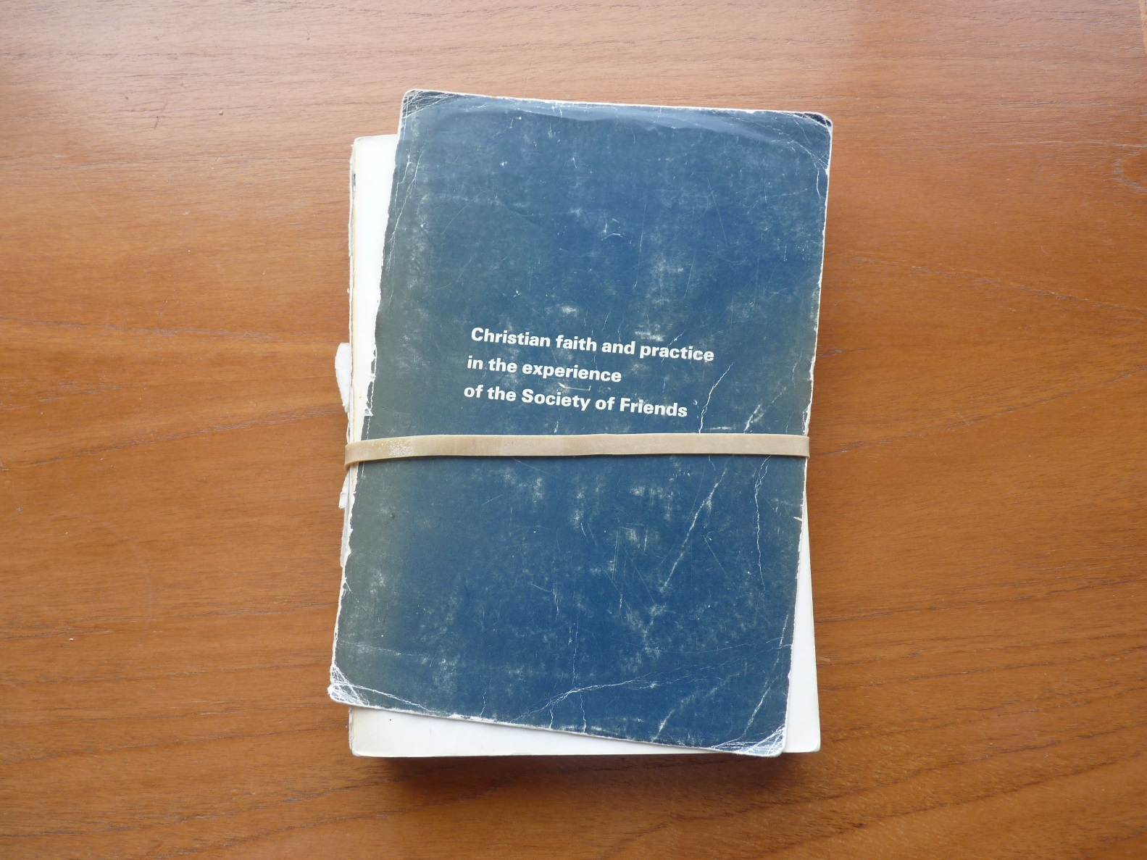

Slide 5
1917
1967
1906
1931
?
1900
1900
1920
1940
1960
1980
2000
2020
Today
7304 days
43216 days
7305 days
Revisions (not reviews) of Church Government

Slide 6
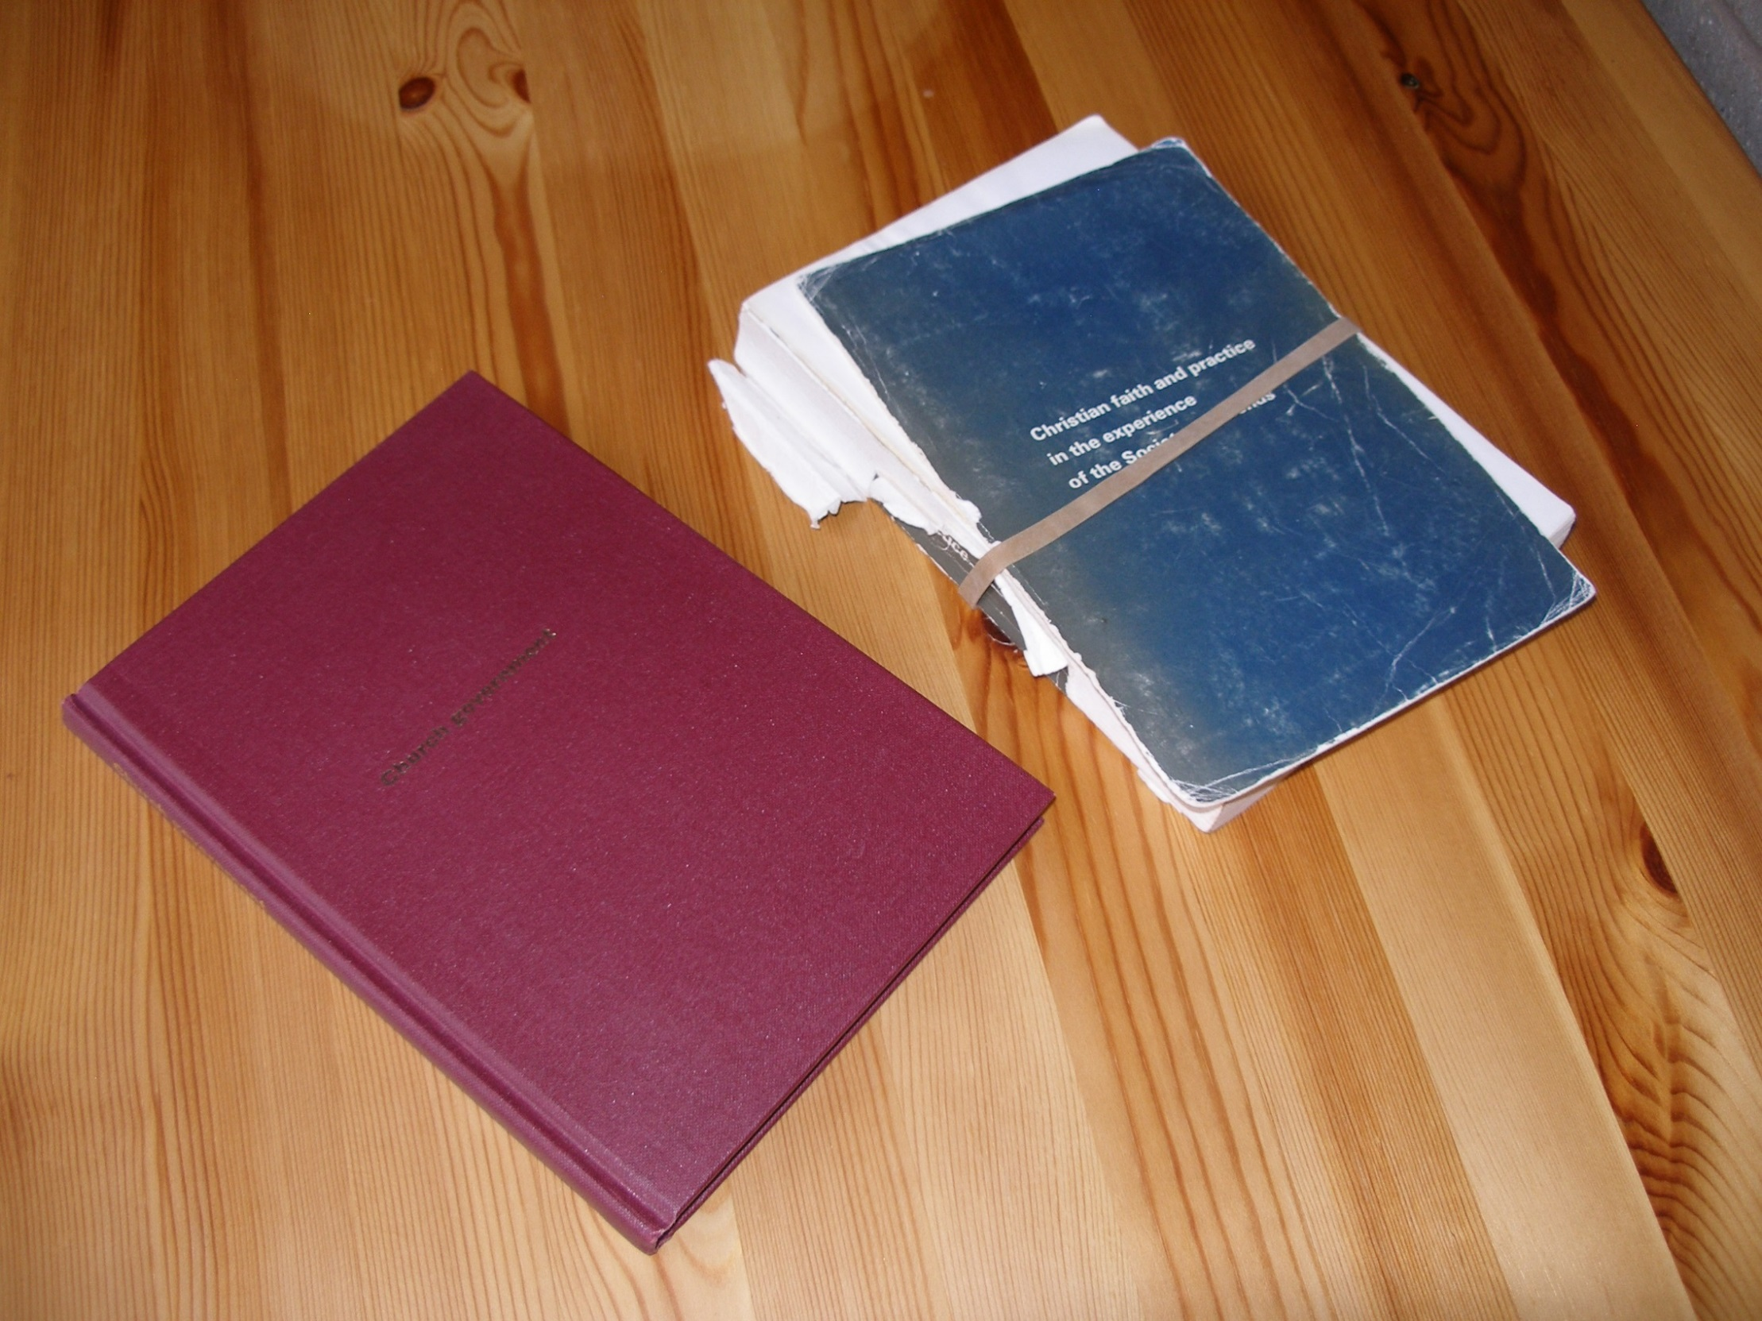

Slide 7
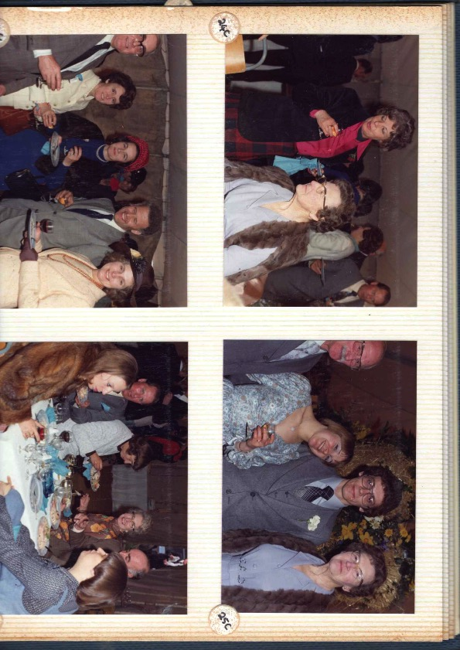
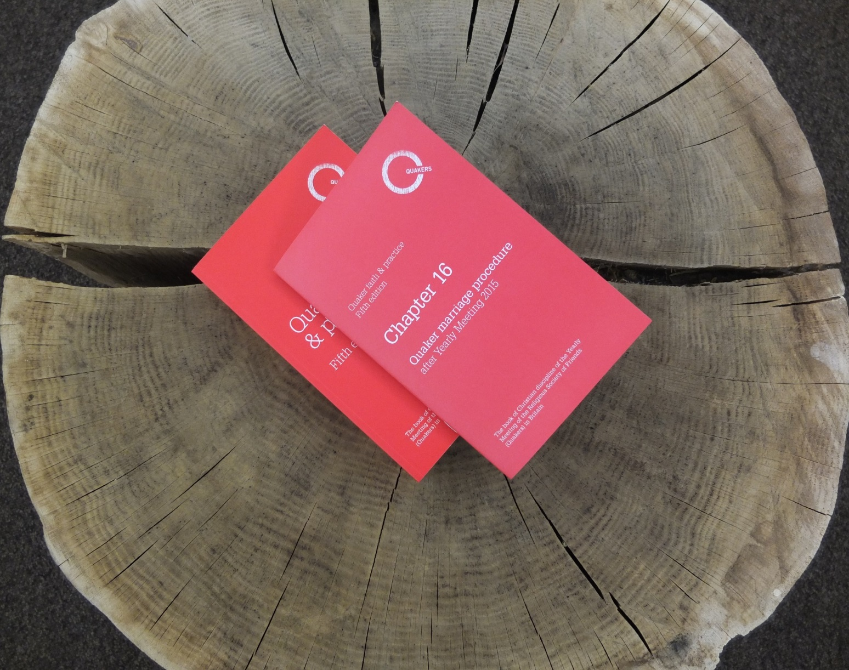

Slide 8
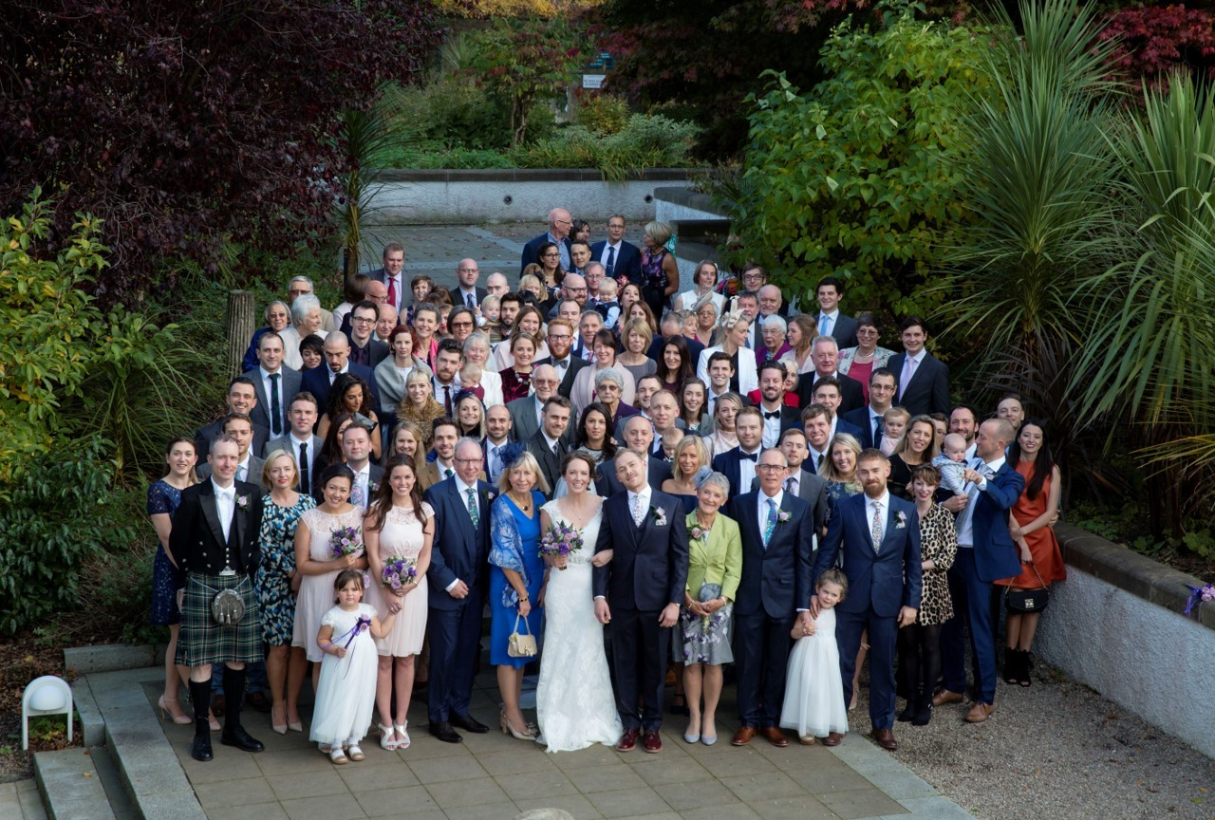
?

Slide 9
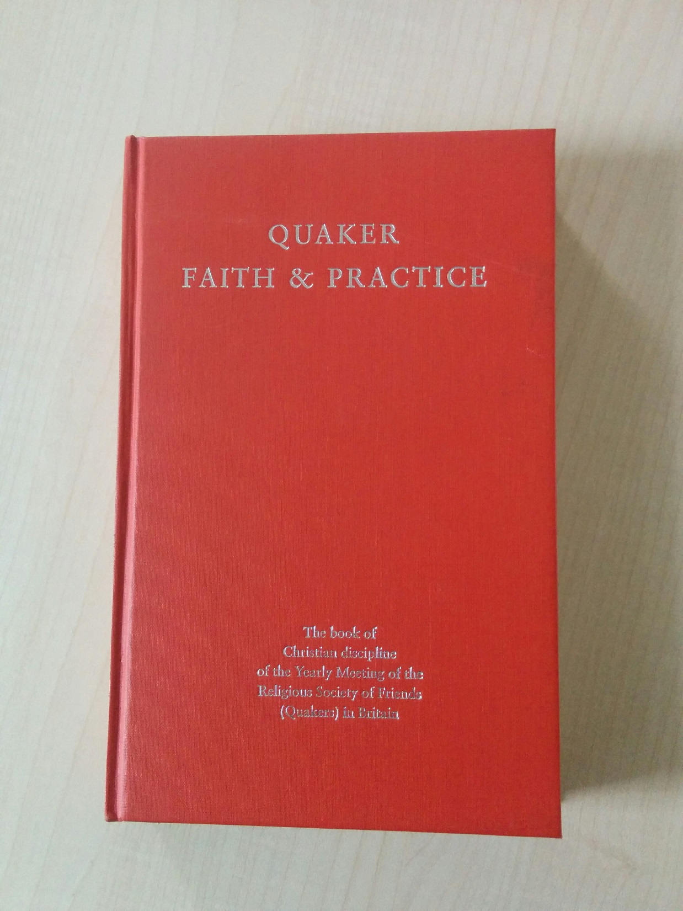

Slide 10
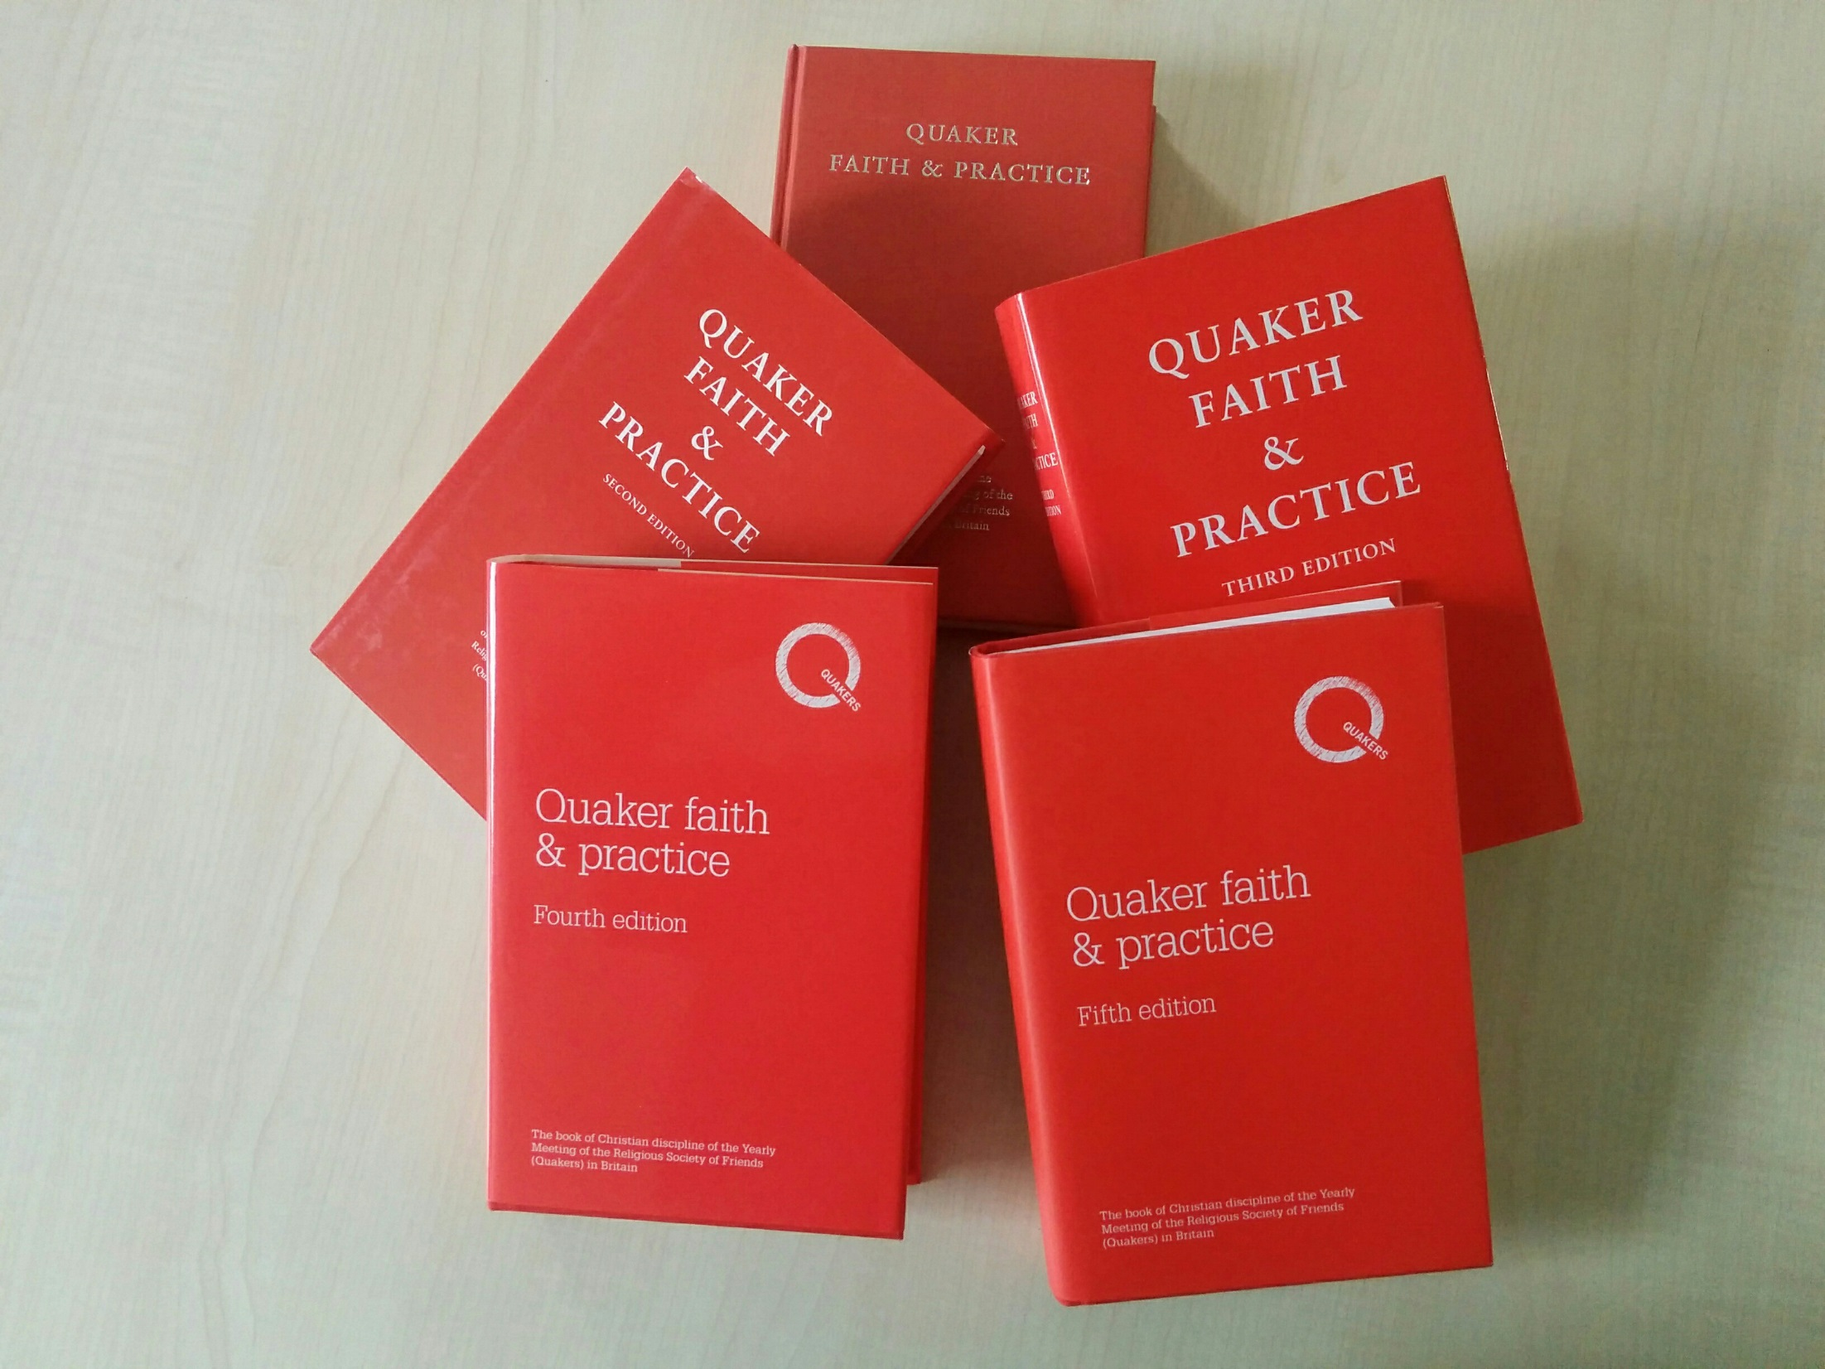

Slide 11


Slide 12

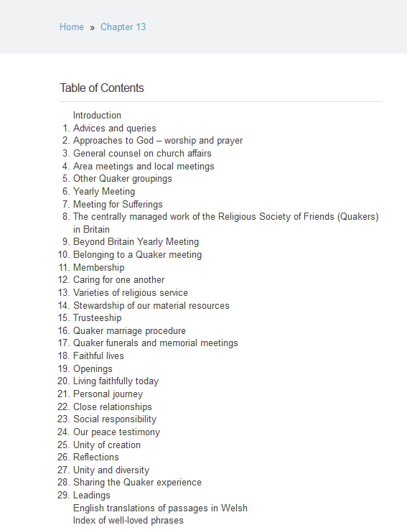
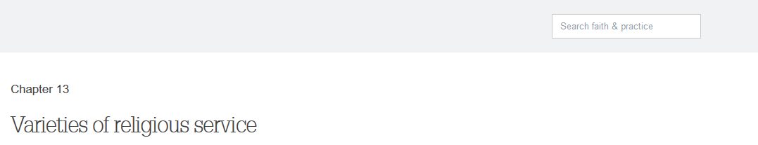
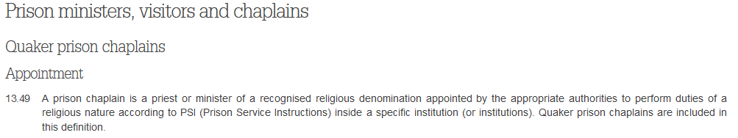
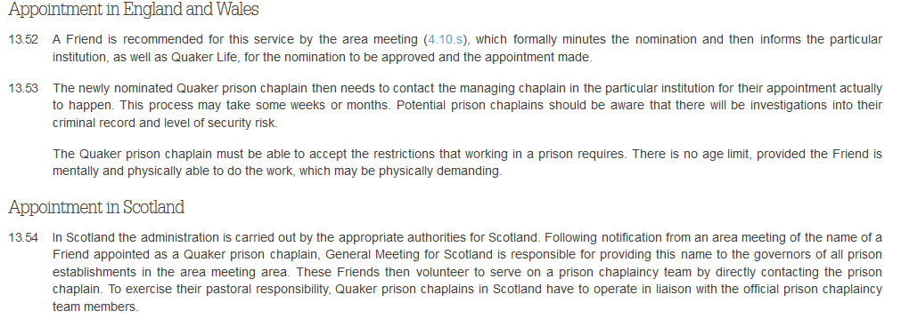

Slide 13
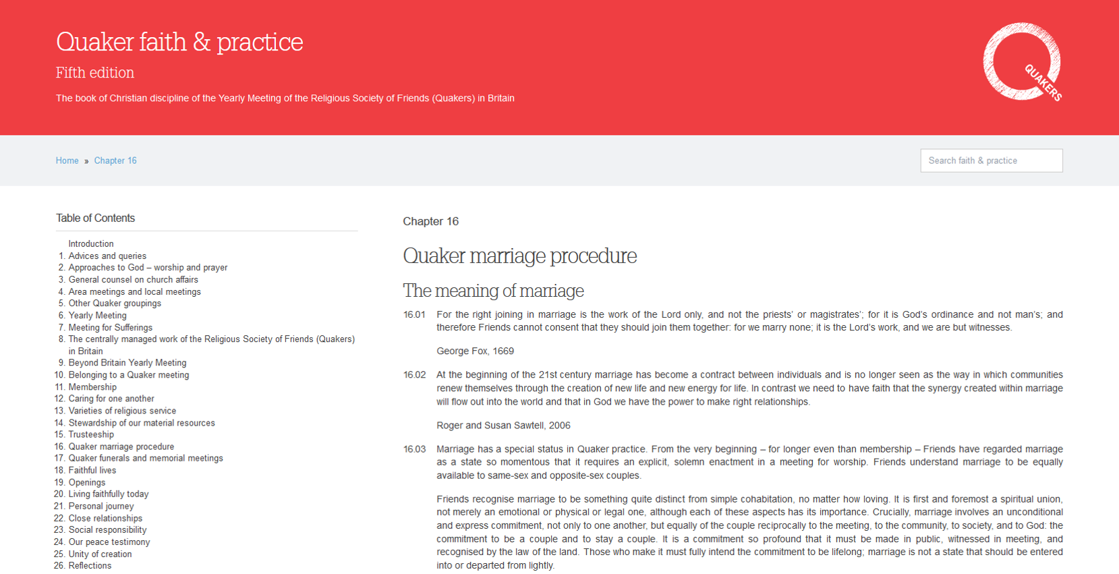
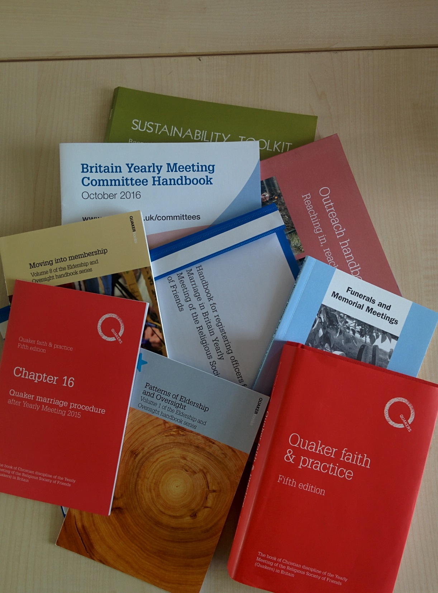

Slide 14


Slide 15


Slide 17
Core
Supplementary
Principles
Agreed by YM
Printed and online
Eg How we hold a business meeting and why
Experience
Handbooks
Agreed by appropriate body
Online and can be printed
Eg advice to clerks about keeping adequate records

Slide 18
Chapter 16 - Quaker Marriage Procedure
Core?
Supplementary?
1-15 The meaning of marriage
16 Conversions of civil partnerships
17-21 Summary of procedure
22-24 Registering Officers
25-32 Detailed marriage procedure
33-45 Civil law requirements
46-56 The Quaker marriage
57-65 Recording of marriages
66-67 Celebration of commitment

Slide 19
Theism/Nontheism
Religious Difference

Slide 20


Slide 21
Listening Openheartedly

Slide 22
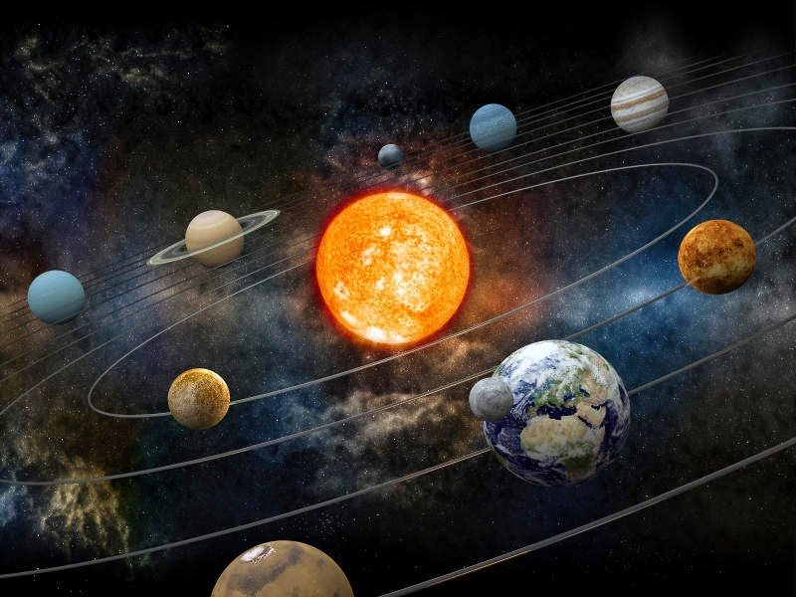
Subatomic particles

Slide 23
What canst thou say?

Slide 24
Don’t do half a job

Slide 25
Don’t do half a job
Core / Supplementary split
Difference a richness not a flaw
Be creative

Slide 26
Speaking as me not clerk of RPG

Slide 27
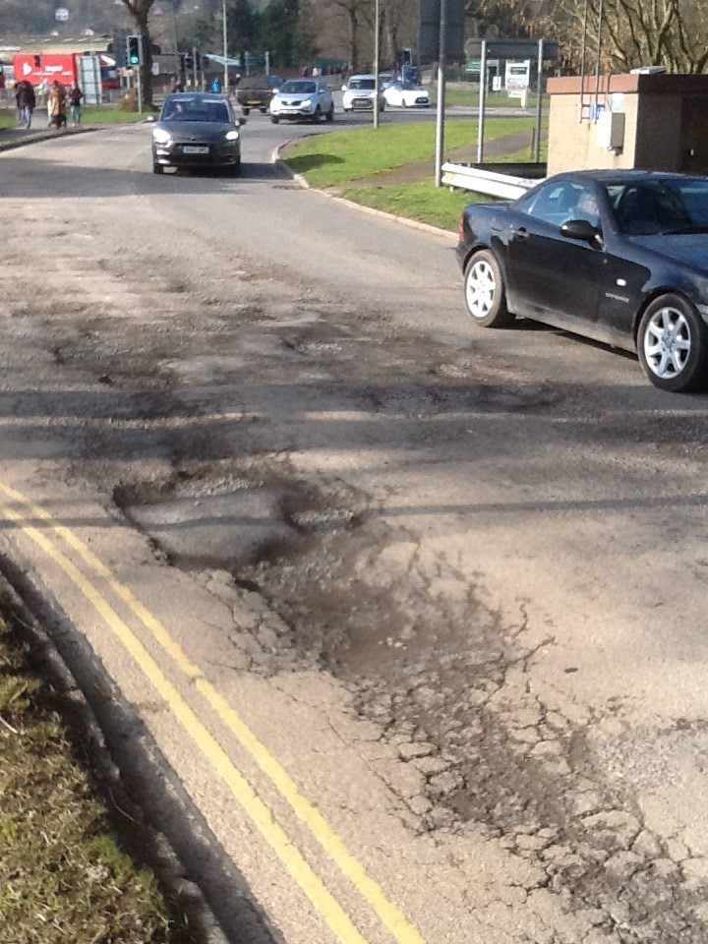
Patching and repatching

Slide 28


