Slide 1


Journeys in the Spirit April 2020
VE Day 1945-2020
John’s story from World War 2.
Your “cry for peace” this VE Day

Slide 2
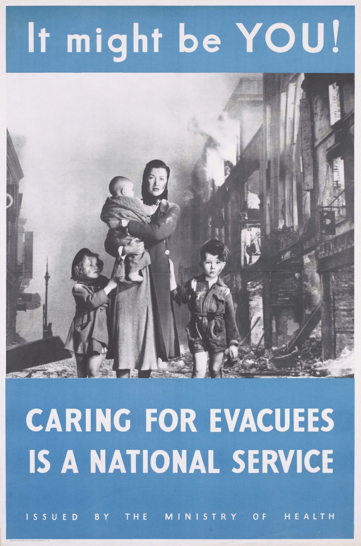
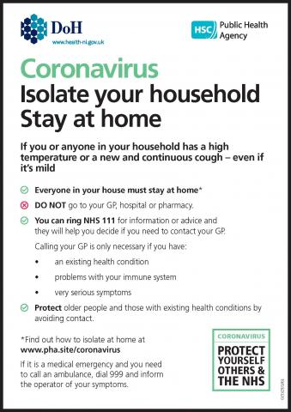
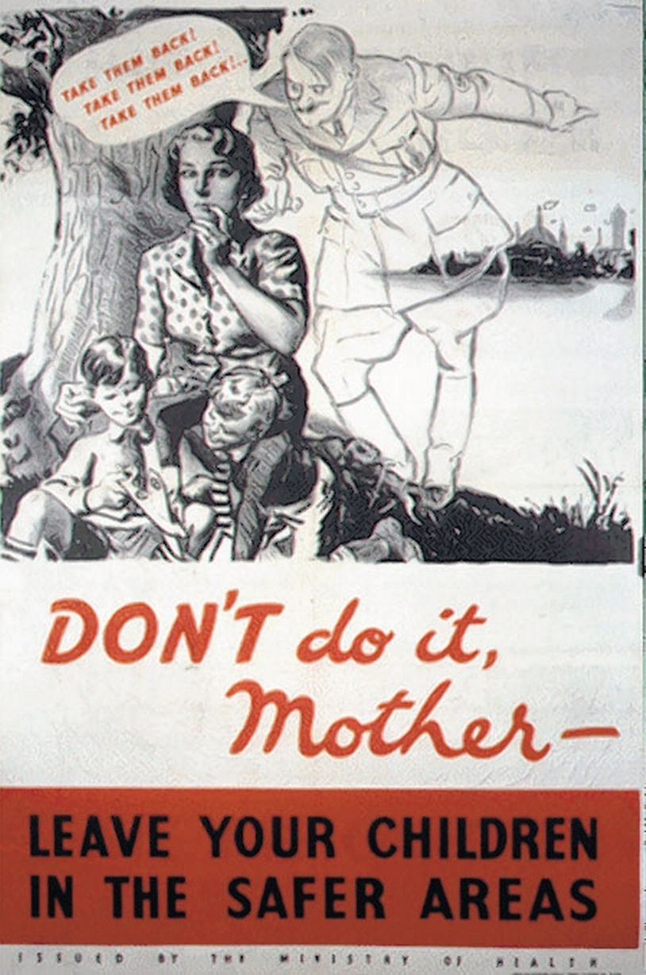
Crisis then and now

Slide 3
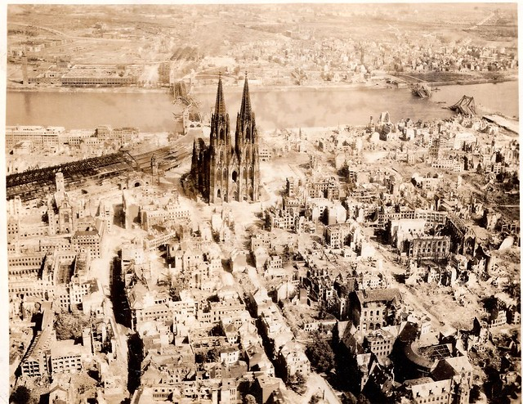
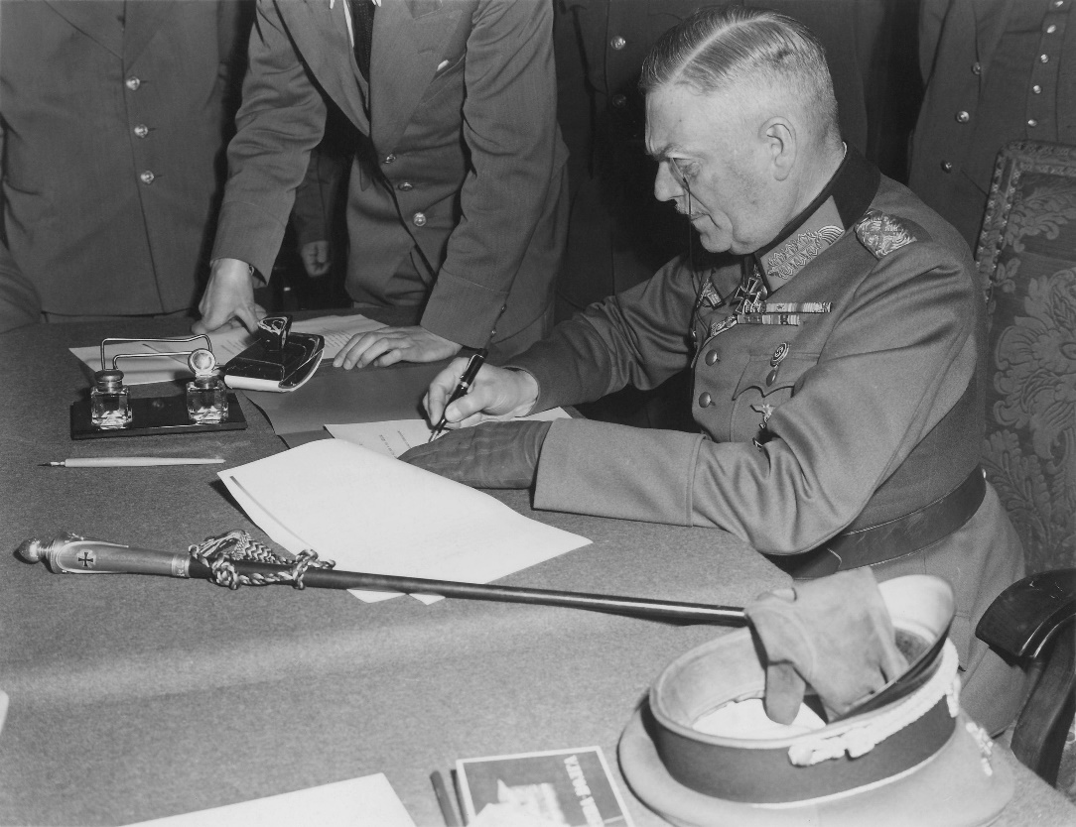
On 7 May 1945 Germany signed an unconditional surrender, ending World War II in Europe.

Slide 4
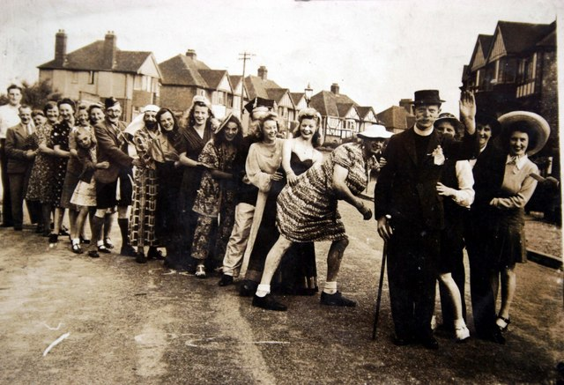
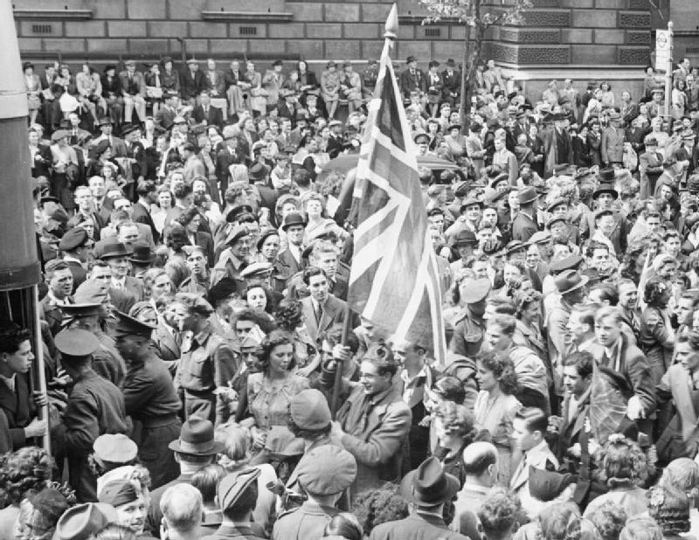
8 May was declared a national holiday, and people around the world celebrated the end of nearly six years of fighting.

Slide 5

How did Quakers respond to the moment fighting stopped in Europe?

Slide 6
“We meet in thankfulness and with a sense of relief at the end of open hostilities in Europe, but we know that hatred, devastation, hunger and suffering remain…Looking to the future, we pray for insight and a gift of effective service uniting us with the wounded body of humanity. We rejoice that already a message of friendship has been taken to many parts of the world by members of the relief service, most of whom are young.”
Yearly Meeting Epistle 1945

Slide 7
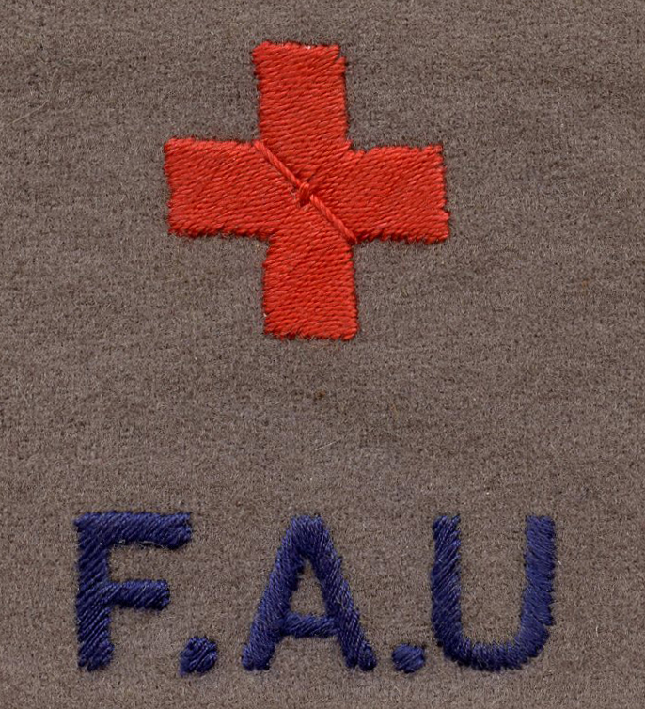
John’s Story
John was at school when the war started. He didn’t think that fighting was a good way to solve problems. When he left school, aged 18, he joined the Friends Ambulance Unit. The Friends Ambulance Unit was a group of men and women who helped people that had been hurt in the war.
For four years John worked in hospitals in Britain, France and the Middle East. Then VE day came, and the war in Europe ended. John was relieved that people weren’t fighting anymore. He had seen all the damage the war had done though, and he knew someone needed to help fix it. So he asked to be sent to Germany.

Slide 8
John’s Story
As John and his team drove over the border they saw a sign saying “This is Germany. Do not fraternize”. That was an order from the army. It meant that John was not allowed to be friends with any Germans. During the war some Germans, called Nazis, had done some very bad things and hurt lots of people. Many of the Allied soldiers were very angry with the Germans because they blamed all of them for the things the Nazis had done. They didn’t trust the German people and they didn’t want to be friends with them.
THIS IS GERMANY
DO NOT FRATERNIZE

Slide 9
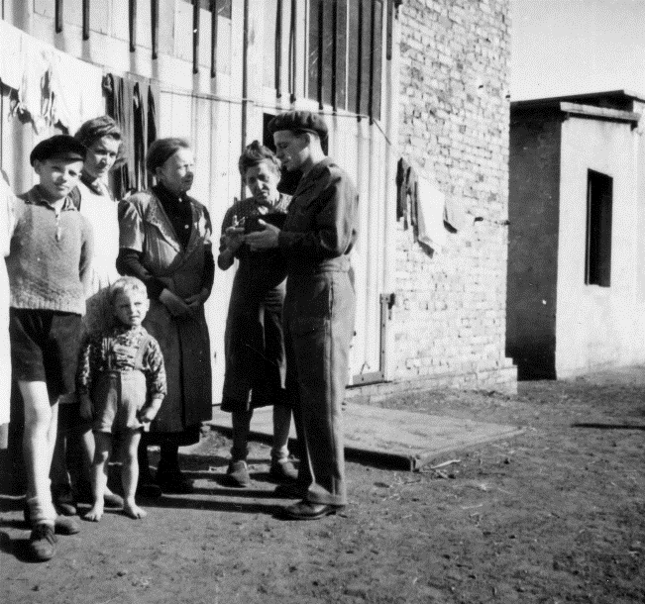
John’s Story
John went to work in a city called Dortmund. It had been very badly damaged by Allied bombs. Lots of people who lived there needed help. The Friends Ambulance Unit provided food, medicine, blankets and toys to those who didn’t have any.
John’s work could be difficult. There was not much food, and it could be hard to get the things the team needed, like parts for their ambulance. To begin with he didn’t speak much German, so it was tough to communicate with people.

Slide 10
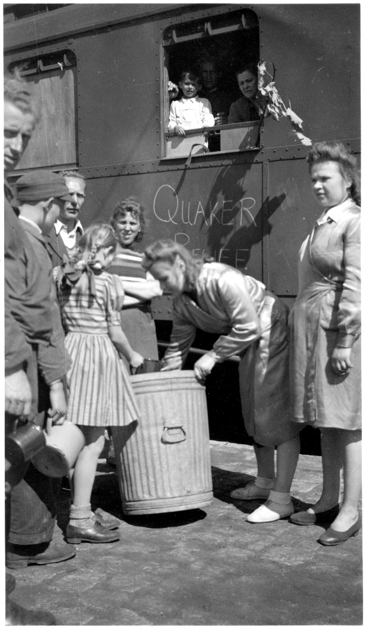
John’s Story
The Germans were also very angry and suspicious of all the people who had come into their country, including the Allied soldiers and the Friends Ambulance Unit. Many of their homes had been destroyed by Allied bombs, which had also hurt their friends. Their government had lied to them and told them the Allies were all cruel, so they were afraid. Most of the food was going to the people the Nazis had hurt, so ordinary Germans weren’t getting enough.
John saw that the Germans were people just like him and his friends. Some were kind and some were mean. Some did clever things and some did silly things. Some were brave and some were cowardly. Even though the army said not to, John wanted to be friendly with them.

Slide 11
John’s Story
So John and his team went to live with some of the Germans, to help them feel safe from angry Allied soldiers. They gave up some of their food rations so the Germans could have more. They spoke to Allied soldiers and Germans to try and help them to stop being angry. Gradually they began to make friends with both Germans and Allied soldiers.
Sometimes John felt sad, because he thought the work he was doing was “only a drop in a big bucket”, but he kept going, and 50 years later he was able to go back to a peaceful Germany and visit many of the friends he had made there.

Slide 12
John’s Story - discussion
What made John’s job harder?
Why do you think the Germans and the Allies were so angry with each other?
Is it fair to blame the whole country for the actions of some people?
When have you been angry? How did this affect your thinking? What made you feel better?
In the story how did John act like a peacemaker?
How can we be peacemakers in our own lives?

Slide 13
Activity - Cry for Peace
One of the planned parts of the official VE day celebration is a “cry for peace”, which will be shouted out by town criers around the country. What would your cry for peace be? Does it need to be loud? Does it need to be spoken at all? Could it be acted out? Is it something you do once, or do you do it every day? Might it be something you draw or write?
Idea - One way Quakers have cried for peace is by using posters. Look at some of the posters Quakers have produced in the past (examples attached). What symbols do we use for peace? What colours? What words? Do the words from the Quaker epistle give you ideas?
Come up with your own peace poster to cry for peace on VE day 2020. Perhaps you can put it in your window for neighbours to see, or share it online.

Slide 14
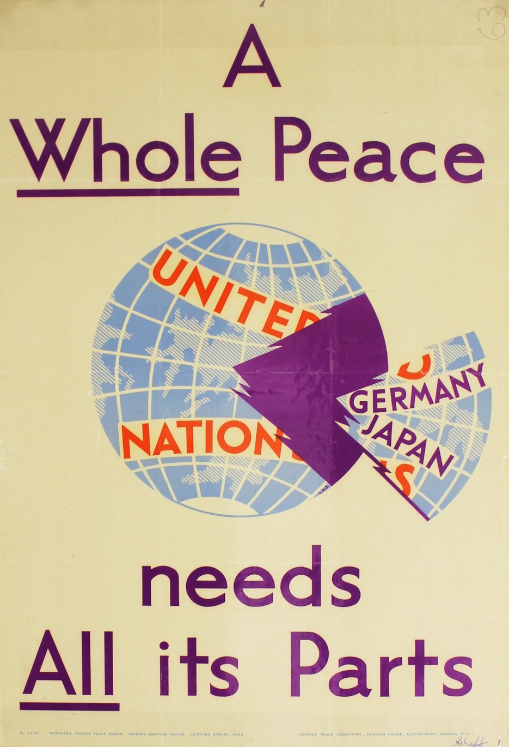

Slide 15


Slide 16


